Slide 1
Design for Verification Project Update
2021-03-08
Eldrick Millares, Jack Humphries (eldrick, jhumphri@stanford.edu)

Slide 2
Tasks Completed
Investigated VScale w/ CSR Enabled Behavior
Enumerated Vscale Modifications
Enumerated RideCore Modifications (In-Progress)
Conversation with Shashank

Slide 3
VScale - CSR Validation and Design Modifications
Fails when QED-style test interleaves an instruction
Looking at trace - specifically fails on sltiu instructions
investigating if it is specific to this instruction / style of instructions
Vscale source files largely untouched - all modifications at top level module only
QED module insertion
CSR register file disabled and relevant signals grounded
Points to simple designs satisfying SSS constraints
VScale implements an outdated RV32IM+Zicsr (32b + Multiplication + CSRs)
Outlook: SQED + SSS runs on RV32IM, Short Pipeline, In-Order, Single Issue Processors

Slide 4
RideCore - Design Modifications
Still in progress - ~ 7000 lines differ across the design files
Shashank mentioned that most of these differences are cosmetic only or are fixes for true design bugs

Slide 5
Conversation with Shashank
Discussed Proof Sketch Motivation + Future Work
Formulated empirically and iteratively
Will need to examine new designs / larger ISAs to expand the proof
Discussed Extremal Bug Generation + Timeout
Tool that generates exitst as a Python script somewhere on rsg cluster
Timeout occurred because unroll depth not large enough to trigger ~3% of bugs
Discussed RideCore + VScale results
Most modifications made were bug fixes or cosmetic
Question: Was this ran on OpenSPARC v2?
No mention in any of drafts, but was possibly done by Eshan

Slide 6
Tasks Planned
Deploy on New Simple Design
Deploy on New Complex Design
Proof Sketch Rework
Will be informed by results from Task 1 and 2 above
Interesting Case Studies
Fast Path Multiplication Example
Lower priority than deploying on new designs

Slide 7
Deploying on New Designs
Own findings + meeting with Shashank motivate deploying on new designs
Want to explore different u-arch features or ISA extensions
RISC-V Cores Database: https://riscv.org/exchange/cores-socs/
~40 open-source designs spanning levels of complexity and ISA extensions
Most designs are up-to-date with current RISC-V Specification

Slide 8
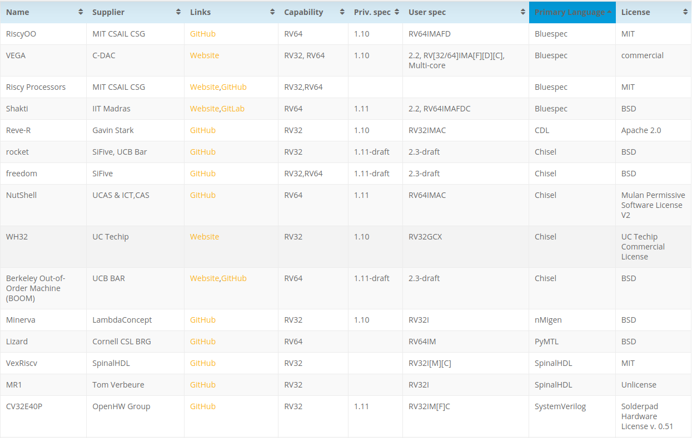

Slide 9
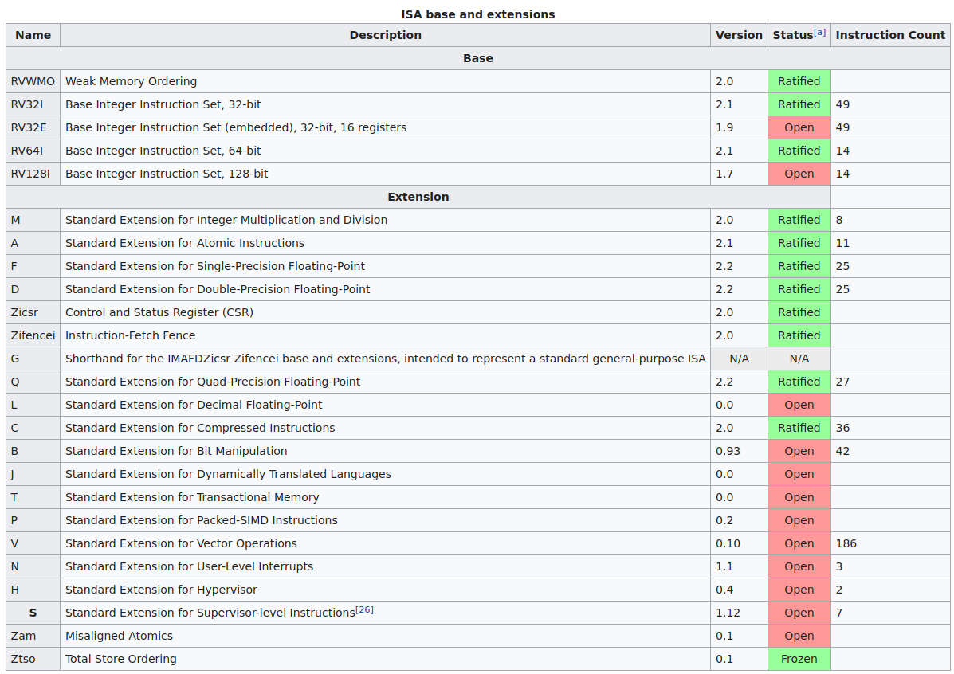

Slide 10
Deploying on New Designs (cont)
Goal: Deploy our technique on a 2 designs out-of-the-box from the list above
Two parameters: uArch complexity and ISA complexity
Simple Design (PicoRV32 - RV32IMC (Integer + Multiplication + Compressed Instructions)
https://github.com/cliffordwolf/picorv32
Complex Design (NeoRV32 - RV32… (Atomics + User Mode + Fences + …)
https://github.com/stnolting/neorv32
Identify and Trace Any SQED + SSS Failures
Due to a uArch feature?
Due to an ISA-extension?
Input into our our proof process
Notes:
Also: Steel (RV32IM+Zicsr)
https://github.com/rafaelcalcada/steel-core

